Slide 1
Java Testing. Spring JMS. Kafka. Elasticsearch

Slide 2
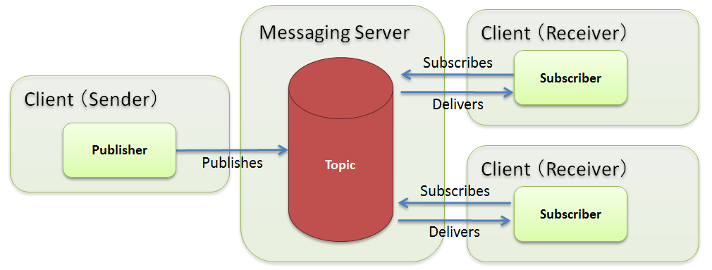
Spring JMS

Slide 3
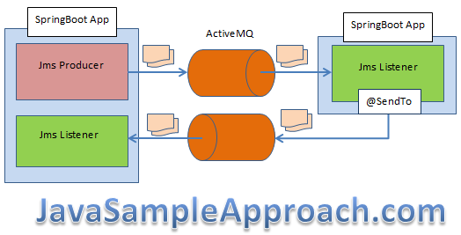
Spring JMS

Slide 4
Spring JMS
@Configuration @EnableJms @ComponentScan(“kz") public class AppConfig { @Bean HornetQQueue topicName() { return new HornetQQueue("topicName"); } @Bean ConnectionFactory connectionFactory() { Map<String, Object> connDetails = new HashMap<>(); connDetails.put(TransportConstants.HOST_PROP_NAME, "127.0.0.1"); connDetails.put(TransportConstants.PORT_PROP_NAME, "5445"); TransportConfiguration transportConfiguration = new TransportConfiguration( NettyConnectorFactory.class.getName(), connDetails); return new HornetQJMSConnectionFactory(false, transportConfiguration); }
@Bean public JmsListenerContainerFactory<DefaultMessageListenerContainer> jmsListenerContainerFactory() { DefaultJmsListenerContainerFactory factory = new DefaultJmsListenerContainerFactory(); factory.setConnectionFactory(connectionFactory()); factory.setConcurrency("3-5"); return factory; } @Bean JmsTemplate jmsTemplate() { JmsTemplate jmsTemplate = new JmsTemplate(connectionFactory()); jmsTemplate.setDefaultDestination(topicName()); return jmsTemplate; } }

Slide 5
Spring JMS
@Component("messageListener") public class SimpleMessageListener{ private static final Logger logger = LoggerFactory.getLogger(SimpleMessageListener.class); @JmsListener(destination = "topicName", containerFactory = "jmsListenerContainerFactory") public void onMessage(Message message) { TextMessage textMessage = (TextMessage) message; try { logger.info(">>> Received: " + textMessage.getText()); } catch (JMSException ex) { logger.error("JMS error", ex); } } }
public class AppConfig { @Bean public JmsListenerContainerFactory<DefaultMessageListenerContainer> jmsListenerContainerFactory() { DefaultJmsListenerContainerFactory factory = new DefaultJmsListenerContainerFactory(); factory.setConnectionFactory(connectionFactory()); factory.setConcurrency("3-5"); return factory; } @Bean JmsTemplate jmsTemplate() { JmsTemplate jmsTemplate = new JmsTemplate(connectionFactory()); jmsTemplate.setDefaultDestination(topicName()); return jmsTemplate; } }
@Component("messageSender") public class SimpleMessageSender implements MessageSender { private static final Logger logger = LoggerFactory.getLogger(SimpleMessageSender.class); @Autowired private JmsTemplate jmsTemplate; @Override public void sendMessage(final String message) { jmsTemplate.setDeliveryDelay(5000L); this.jmsTemplate.send(new MessageCreator() { @Override public Message createMessage(Session session) throws JMSException { TextMessage jmsMessage = session.createTextMessage(message); logger.info(">>> Sending: " + jmsMessage.getText()); return jmsMessage; } }); } }

Slide 6
Kafka.
@EnableKafka @Configuration public class KafkaConsumerConfig { @Bean public ConsumerFactory<String, String> consumerFactory() { Map<String, Object> props = new HashMap<>(); props.put( ConsumerConfig.BOOTSTRAP_SERVERS_CONFIG, bootstrapAddress); props.put( ConsumerConfig.GROUP_ID_CONFIG, groupId); props.put( ConsumerConfig.KEY_DESERIALIZER_CLASS_CONFIG, StringDeserializer.class); props.put( ConsumerConfig.VALUE_DESERIALIZER_CLASS_CONFIG, StringDeserializer.class); return new DefaultKafkaConsumerFactory<>(props); } @Bean public ConcurrentKafkaListenerContainerFactory<String, String> kafkaListenerContainerFactory() { ConcurrentKafkaListenerContainerFactory<String, String> factory = new ConcurrentKafkaListenerContainerFactory<>(); factory.setConsumerFactory(consumerFactory()); return factory; } }
@Configuration public class KafkaProducerConfig { @Bean public ProducerFactory<String, String> producerFactory() { Map<String, Object> configProps = new HashMap<>(); configProps.put( ProducerConfig.BOOTSTRAP_SERVERS_CONFIG, bootstrapAddress); configProps.put( ProducerConfig.KEY_SERIALIZER_CLASS_CONFIG, StringSerializer.class); configProps.put( ProducerConfig.VALUE_SERIALIZER_CLASS_CONFIG, StringSerializer.class); return new DefaultKafkaProducerFactory<>(configProps); } @Bean public KafkaTemplate<String, String> kafkaTemplate() { return new KafkaTemplate<>(producerFactory()); } }
@Autowired private KafkaTemplate<String, String> kafkaTemplate; public void sendMessage(String msg) { kafkaTemplate.send(topicName, msg); }
@KafkaListener(topics = "topicName", groupId = "foo") public void listenGroupFoo(String message) { System.out.println("Received Message in group foo: " + message); }

Slide 7
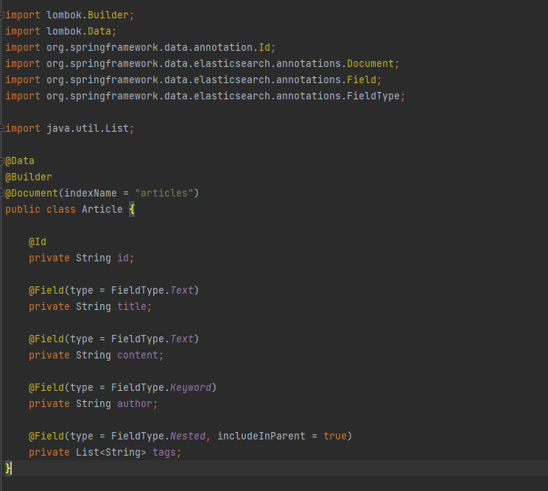
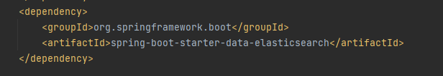

Elasticsearch

Slide 8
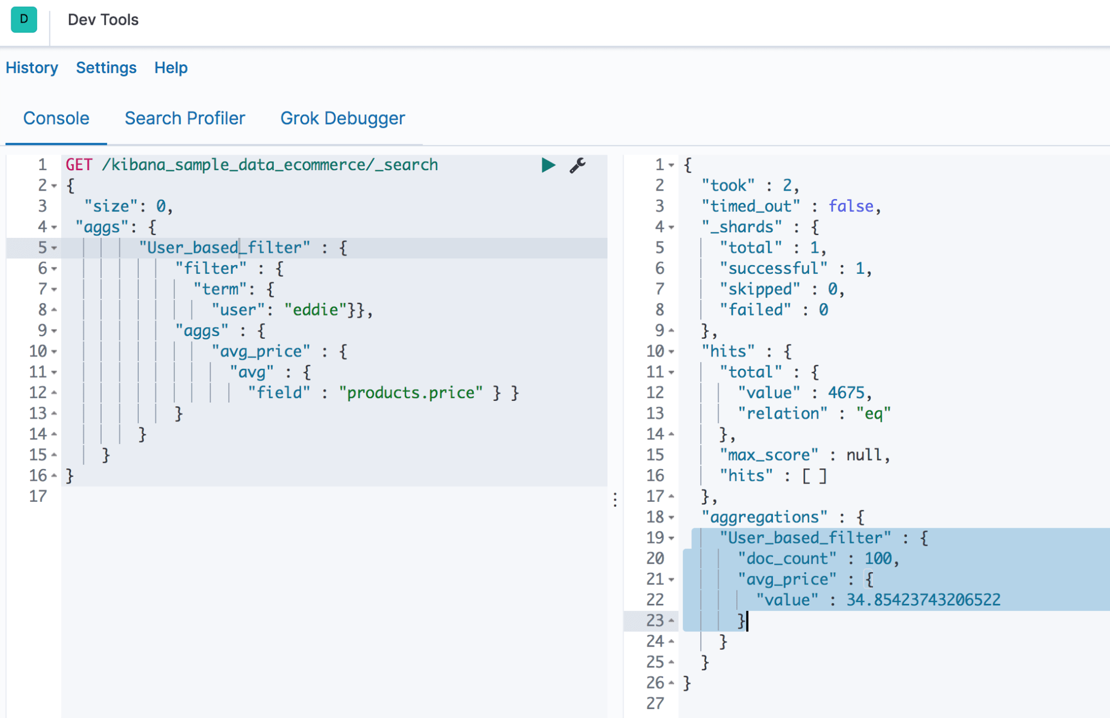
Elasticsearch
public interface ArticleRepository extends ElasticsearchRepository<Article, String> { Page<Article> findByAuthorsName(String name, Pageable pageable); @Query("{\"bool\": {\"must\": [{\"match\": {\"authors.name\": \"?0\"}}]}}") Page<Article> findByAuthorsNameUsingCustomQuery(String name, Pageable pageable); }

Slide 9
Elasticsearch
@Configuration @EnableElasticsearchRepositories(basePackages = "com.baeldung.spring.data.es.repository") @ComponentScan(basePackages = { "com.baeldung.spring.data.es.service" }) public class Config { @Bean public RestHighLevelClient client() { ClientConfiguration clientConfiguration = ClientConfiguration.builder() .connectedTo("localhost:9200") .build(); return RestClients.create(clientConfiguration).rest(); } @Bean public ElasticsearchOperations elasticsearchTemplate() { return new ElasticsearchRestTemplate(client()); } }
@Document(indexName = "blog") public class Article { @Id private String id; private String title; @Field(type = FieldType.Nested, includeInParent = true) private List<Author> authors; // standard getters and setters }
String nameToFind = "John Smith"; Page<Article> articleByAuthorName = articleRepository.findByAuthorsName(nameToFind, PageRequest.of(0, 10)); Query searchQuery = new NativeSearchQueryBuilder() .withFilter(regexpQuery("title", ".*data.*")) .build(); SearchHits<Article> articles = elasticsearchTemplate.search(searchQuery, Article.class, IndexCoordinates.of("blog");

Slide 10
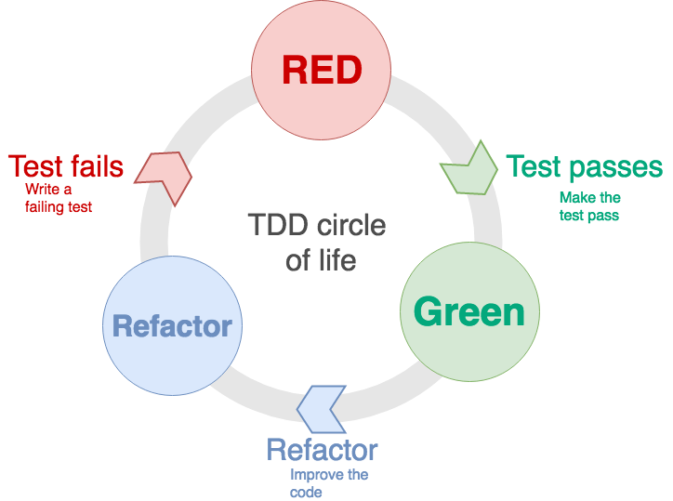
Spring Testing
Logic unit test
Integration unit test
Front-end unit test
Continuous build and code quality test
System integration test
System quality test
User acceptance test

Slide 11
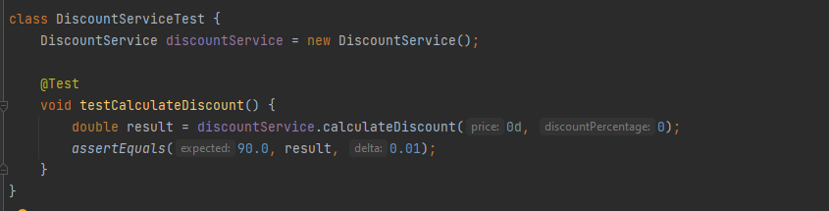
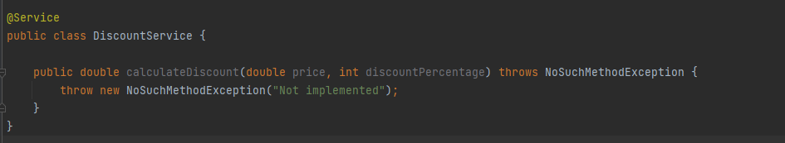
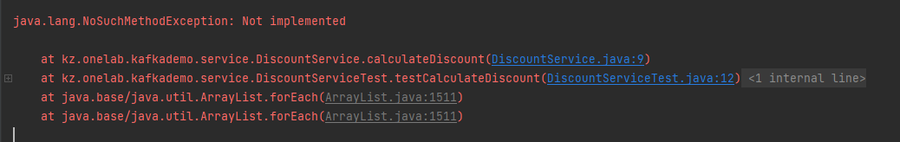

Slide 12
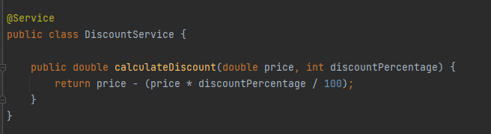


Slide 13
